Slide 1
ALUMNI RELATIONS
Notes:
Welcome message

Slide 2
LEARNING OBJECTIVES
Identify Rotary alumni
Discuss ways to connect with alumni
Discuss ways to involve alumni in Rotary clubs
Notes:
Review learning objectives.

Slide 3
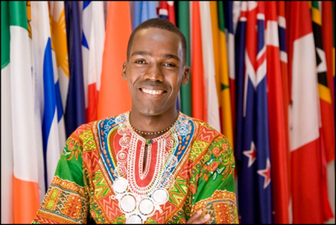
ALUMNI
Ambassadorial Scholars
Group Study Exchange participants
Rotary Grants for University Teachers
Rotary Peace Fellows
Rotary Volunteers
Rotary Youth Exchange participants
District grant recipients
Notes:
These are some of the individuals who are considered Rotary Alumni.
There are approximately 43,000 alumni from Scholarships, 70,000 from Group Study Exchange, and 7,000 from other programs.

Slide 4
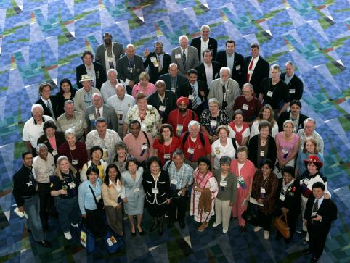
ALUMNI
Over 120,000 total
Less than 1/3 are Rotarians
Many alumni have participated in more than one program
Enormous potential for membership
Notes:
There are over 120,000 Rotary alumni, who are an important part of Rotary’s network.
Promote alumni so that other Rotarians understand their importance – have them speak at a meeting.
Feature alumni in club and district newsletters.
Encourage Rotarians to attend Rotaract/Interact meetings.
ASK: Are you aware of the alumni in your club?

Slide 5
ROTARY ALUMNI
Encourage alumni to maintain a lifelong relationship with Rotary:
Service project participation
Rotary club membership
Rotaract club membership
Alumni association activities
Contributions to the Foundation
Notes:
Clubs should build relationships with alumni to encourage them to maintain a lifelong connection with Rotary. They can do this by:
Inviting them to participate in a club or district service project
Inviting them to join their club or a Rotaract club
Asking them to participate in an alumni association
Inviting them to assist in participant selection and orientation
Encouraging them to contribute to the Foundation
ASK: How can Rotarians use alumni to tell Rotary’s story to the community?
ASK: What is the best way to stay in contact with your Rotary alumni?

Slide 6
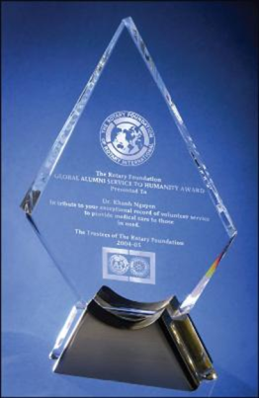
CONNECT WITH ALUMNI
Rotary Peace Symposium
Alumni Association of the Year Award
Global Alumni Service to Humanity Award
Notes:
Connect with Rotary alumni by participating in the Rotary Peace Symposium.
Recognize the good works of your alumni by nominating them for an award.

Slide 7
ALUMNI COMMUNICATIONS
Reconnect quarterly e-newsletter
Rotary Foundation alumni on Facebook
Rotary Reconnections LinkedIn Group
Notes:
Reconnect (formerly Reconnections) e-newsletter reaches over 21,000 alumni and Rotarians quarterly.
Connect with alumni on Facebook or LinkedIn to share stories and invite participation.
ASK: How can you retain alumni interest in Rotary activities?

Slide 8
ALUMNI ASSOCIATIONS
Great strategy for keeping alumni connected
Enable networking between alumni and with Rotarians
Provide alumni service opportunities
Facilitate alumni membership in Rotary and Rotaract clubs
Low-cost, low-commitment way to stay engaged
Notes:
Alumni associations are Rotary’s primary engagement strategy for keeping alumni connected.
Your association format should be flexible and fit the needs and interests of local alumni.
ASK: What are other benefits of establishing an alumni association?
ASK: Does your club consider alumni to be potential donors or members?

Slide 9
SESSION REVIEW
Identify Rotary alumni
Discuss ways to connect with alumni
Discuss ways to involve alumni in Rotary clubs
Notes:
Review the session’s learning objectives that were covered.

Slide 10
TAKE ACTION
Develop an action plan for keeping alumni involved in Rotary activities
Invite alumni to participate in a service project
Assign a member to maintain up-to-date contact information for alumni
Start an alumni association in your area
Notes:
Review action items and ask participants for additional items.

Slide 11
Questions?
alumni@rotary.org
contact.center@rotary.org
Notes:
Ask participants for questions.

